Slide 1


Business plan 2024-2028
Attenborough Learning Trust
STRENGTH THROUGH PARTNERSHIP

Slide 2
Foreword by Chair of Trustees
Lee Jowett
Welcome from the CEO
Jane Ridgewell
Welcome to the 2024-2028 Business Plan for Attenborough Learning Trust. Attenborough Learning Trust was formed in April 2019 and has grown significantly since then, having achieved remarkable results since its inception. The Trust was founded collaboratively, on a strong ethos and moral purpose to support others, so that young people are enabled to achieve their very best. We believe that working closely together with our staff, children and communities will have the most positive impact on the life of every pupil.
Working within an ethos of collaboration and support, we are a family of schools in Leicester. Our outstanding workforce and commitment to community engagement is central to our success. We will continue to invest in our staff, identify and promote talent and use the skills of individuals to make us stronger.
We have achieved a great deal so far but are ready to go further. Through ongoing self-analysis, review and learning from others, we strive to be a trust renowned for its integrity, support and excellent practice in all areas. Following a period of establishment and growth over the past years, we are now ready to expand Attenborough Learning Trust by inviting new partners to join us in this exciting phase of our development so that we work together to deliver excellence for our pupils.
This Business Plan provides a clear strategic direction for the coming years, which will enable the Trust to continue its growth and ensure ‘Strength Through Partnership’.
It gives me great pleasure to provide the foreword to our Business Plan. I am very proud to be associated with the Attenborough Learning Trust and our family of schools each with their own unique identity. From being involved in the very early discussions around forming the Multi-Academy Trust through to being elected as the Chair of the Trust, it has been is a real privilege to see the Trust grow and flourish.
We have high quality governance throughout the Trust that holds the executive team to account. We work collaboratively while recognising our local governing bodies and how they shape the uniqueness of each school. Through our outstanding staff and pupil outcomes we strive to achieve the very best for our children, their families and the wider community. I regularly see outstanding outcomes first-hand in our schools and through word of mouth in the city.
We continually seek to support other schools in the city which provides mutual benefits to both parties.
Our Trust’s foundations are based on a clear strategic direction, strong leadership and excellent financial performance. Using these key foundations I am confident that as we will grow as a trust while working with partners to maintain and build our ethos of “Strength Through Partnership”. I look forward to working with you on this exciting journey.

Slide 3

Our strategic pillARS 2024 - 2028
The key priorities for the Trust over the next four years are set within our strategic pillars to ensure that the Trust is able to realise its core purpose. We want to secure high quality education for all pupils, with provision being led by outstanding leaders and supported by effective monitoring and accountability systems. Whilst maintaining a strong focus on the needs of individual schools within the trust, we want to be outward facing, developing and sharing effective practice with other schools in the wider system.
Our Children
Our People
Our Infrastructure
Our Partnerships
Our Community
Our Governance

Slide 4



OUR MISSION AND PURPOSE
Our children will benefit from the increased learning opportunities created by access to a wider experienced pool of specialist teaching and support staff and a wider range of resources resulting in improved outcomes and life chances for all.
Our families and carers and the local community will receive enhanced family and carer support including sharing facilities and expertise, improved access to enrichment and support services and a broader range of community services.
Our staff will benefit from increased opportunities to develop and maintain their high-quality teaching practice by utilising access to greater resources and wider peer networks for sharing best practice.
Our partner schools improve their operational effectiveness and efficiency by sharing support and expertise.
Together ALT schools are better placed to contribute to the wider system of education across Leicester. Outward facing and forward thinking, we continuously look for opportunities to share experience, support others and develop ourselves and others.
Our Vision
Become the Trust for world-class quality education and personal achievement through partnership and collaboration
OUR VALUES AND BELIEFS
Working in partnership with other schools in a spirit of collaboration, openness and trust to achieve the highest standards of academic progress and personal achievement
Creating local solutions to local issues
Creating and supporting an active learning community which includes staff, children and families
Keeping children safe
Ensuring that all children have access to high quality learning opportunities tailored to their needs
Using our resources wisely to achieve the best outcomes for children
Ensuring a balance of autonomy for individual schools alongside collective accountability
Providing all staff with enhanced opportunities for professional growth and development

Slide 5


STRENGTH THROUGH PARTNERSHIP
01
02
What makes ALT different from other Trusts?
How Do We Collaborate and Move Forward Together?
Networks of school leaders working together on curriculum and enrichment opportunities.
The Headteacher School Improvement Group work together to ensure a coherent strategic direction and drive is in place.
Each Headteacher is committed to working across the MAT and having an impact beyond their own school.
Quality joint INSET and Continuing Professional Development is in place.
Clear and consistent financial procedures and reporting systems in place across the MAT.
A shared focus on developing teaching and learning brought together through the MAT Business Plan and School Improvement Strategy
Each school has the autonomy to develop and deliver its own curriculum whilst benefitting from joint curriculum networks.
The Trust is based on collaboration and working together for the good of all the children in the Trust, and the wider educational community.
The individual nature of each school, from uniform to holidays and school days, is protected.
Trust staff have the opportunity to work with other schools across the MAT.
A high quality Governance and Executive Leadership structure provides support and challenge.

Slide 6
STRENGTH THROUGH PARTNERSHIP
03
04
What do the schools get out of the trust?
What do we expect from our schools?
A quality Executive Leadership team and Trustee Board to support and challenge the school.
Clear and sound financial procedures which comply fully with the Academies Handbook.
A range of networks which collaborate to improve outcomes across the MAT.
Retained autonomy and control over a number of significant areas.
A shared commitment from all schools that the MAT must be greater than the sum of its parts.
Membership of a Headteacher School Improvement Group charged with ensuring compliance and improvement across the MAT.
Quality financial systems to ensure that school budgets effectively deliver the vision of the Trust and schools.
Buy-in to the Mission, Purpose and Values of the MAT.
Commitment to collaborate fully as a member of the MAT, whatever the circumstances of the school.
Agreement that success and commitment to improve will lead to greater autonomy and rights within the MAT.
Commitment from the Headteacher and other Senior Leaders to spend time supporting and helping other schools across the MAT.
Agreement to follow the financial policies and procedures of the MAT.
A positive attitude to change.
Willingness to report school performance and financial information to Executive Leaders and Trustees.

Slide 7
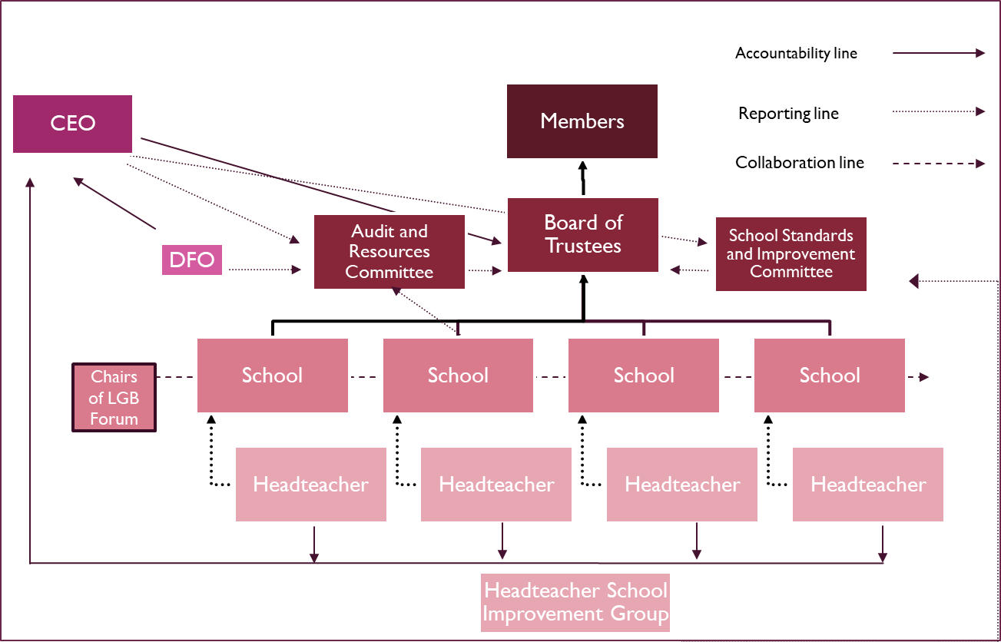
Leadership & Governance Accountability framework
A clear scheme of delegation lays out the delegated authority throughout the MAT.
This works on a principle of earned autonomy with a high level of delegation to headteachers and local governing bodies.
However, when there is an area of underperformance which needs additional support from the trust to ensure rapid improvement, the level of autonomy is reduced. The intervention triggers are clearly laid out within the scheme of delegation and school improvement strategy.
*No. of schools and headteachers is illustrative.

Slide 8




Leadership & Governance
Executive Leadership
We have ensured that all who are part of the governance structure of the Attenborough Learning Trust are committed to our shared values and beliefs. They bring a strong skill set and a desire to serve our community of schools. Full bios and information about all members and trustees are available on our Trust website.
www.attenboroughlearningtrust.org.uk
Members
Board of Trustees
Executive Leadership
  Jason Bell
  Minesh Chauhan
  Gina Samuel-Richards
  Khalid Mahmood
  Lee Jowett, Chair
  Hanif Asmal
  Sunil Desai
  Husein Mussa
  Abdishakur Tarah
  Rob Grant, Vice Chair
  Rose Griffiths
  John Turner
  Zahir Mamujee
  Brian Downes
Chief Executive Officer - Jane Ridgewell
Director of Finance and Operations - Dave Nimmo
Head of School Improvement – Monika Singala
Trust Finance Manager – Tom Bott
Head of Governance – Robyn Cooper
9

Slide 9
School Improvement Strategy
Our long-term aim is to remain a moderate sized local Trust which will ensure that we know our academies and the communities they serve.
Our Trust is built on the premise of collaboration and shared values, and we have sought to strengthen this by evolving over time and not growing too large or too quickly.
Our focus is to develop and enhance our collaborative approach, and in doing so strengthen the practice and outcomes in our schools. This includes focusing on key areas of weakness, sharing staff across the MAT and offering targeted support and coaching where our schools have the greatest need.
Existing
Schools
If a school wishes to join our MAT, clear understanding of the school’s current position is required by our Trustees. This will include a review of data, relevant documentation (i.e. Analyse School Performance, Data Dashboards and OfSTED reports) along with undertaking a due diligence process of the current school position, including finance.
This audit of provision will be a collaborative approach that will be carried out alongside the joining school, taking full account of the school’s own self-evaluation and identified priorities and any external review which has taken place.
We will also establish the joining school’s own areas of strength and expertise that can be shared across the Trust and, in particular, the skills of staff within the school.
New schools will have access to all the shared services provided by the Trust.
Where new schools are not already performing strongly the Trust will facilitate a high quality, bespoke package of support formulated and agreed by our CEO.
New Schools
An Annual Performance Dialogue and Risk Assessment will be carried out with all schools and monitored at least termly. This will inform the level of support required by the school. In the spirit of our leadership culture, the willingness of the school to engage with school improvement activity and the leadership capacity necessary to drive these improvements in the school will be evaluated as part of the risk assessment process.
Our intervention strategy will operate at three levels, together with the schedule of monitoring of actions arising from the Annual Performance Dialogue and Risk Assessment. At every level, the opportunity will be given to the Headteacher and Local Governing Body to provide contextual information and narrative to the process.
School Improvement Ethos & Strategy

Slide 10







SERVICES WE PROVIDE
We offer schools the following centralised services, from the top slice that is drawn from each member school.
School Improvement
School Improvement, including enhanced SEND support services
Centrally organised networks, CPD and coaching
HR Support & Consultancy
Payroll and contract support
Legal support and Advice
Estates Management
Bidding to DfE
Compliance framework
Additional Support
Brokerage of Insurance
Brokerage of other core services on request
Finance Support
Preparing financial statements in line with the Department for Education (DfE) and Education Funding Agency (EFA) requirements
Budget preparation and monitoring
Taxation advice
VAT returns
Asset management
Monthly/Quarterly management accounts
Software and processes training for school finance staff
Financial management co-ordination
Integrated Financial Management System (PS financials)
Payroll bureau and pension reporting services
Central Procurement
Centrally managed procurement for key services
Access to internal contracts and frameworks
Governance
Support for high quality governance and recruitment
Skills audits and bespoke governor training

Slide 11
Milestones (to be drafted)
Attenborough Learning Trust
DEVELOPMENT STRATEGIES 2024-2028

Slide 12
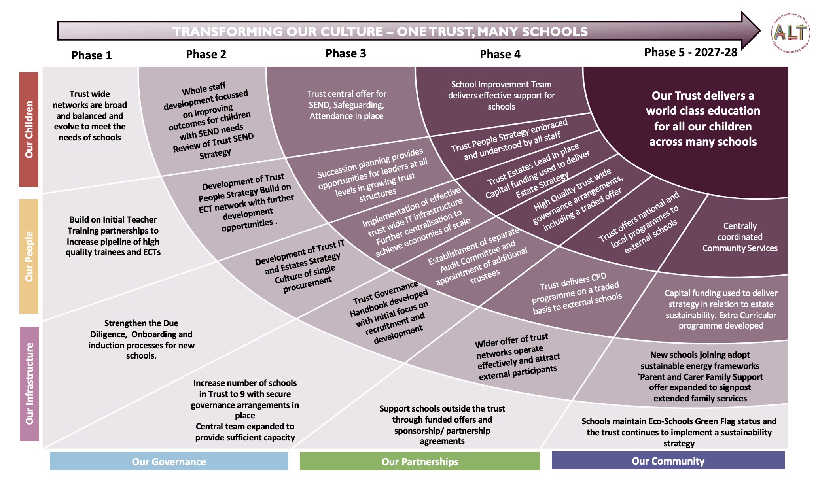
4 year Transformation map

Slide 13
Development Strategies

